Slide 1
How did you attract/address your audience?
Evaluation Question 5

Slide 2
The creative decisions made were based on ideas which were developed about the readers.
Where did these ideas come from?
How did they influence the 'micro' detail of shot composition and framing, anchorage, layout, mode of address and register?

Slide 3
Where did these ideas come from
Popular magazines which my target audience would identify with.
Music which is popular among the potential audience.
The conventions of the chosen genre of music.
The unique selling point of my magazine.

Slide 4
Popular magazines which my target audience would identify with
Kerrang!
Classic Rock
Q
NME
Rock Sound

Slide 5
Conventions of these magazines
Rule of three
Anchorage
Superlatives
The word ‘exclusive’
These factors are relevant due to the magazine’s format and conventions being consistent to the magazines which the audience is familiar with, in addition to portraying the magazine in an business appropriate manner.

Slide 6
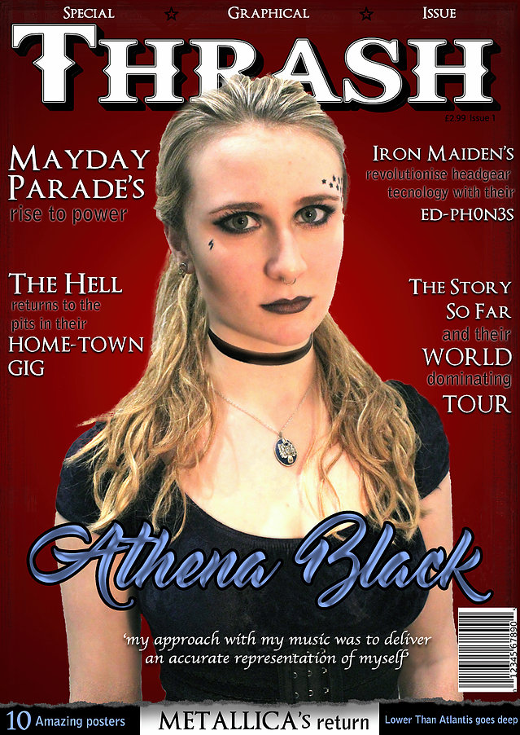
Rule Of Three
A language device, using three words as descriptors or nouns.
The rule of three is based on the technique that people tend to remember three things.
The use of this device enabled my magazine to replicate Kerrang!’s presentation of special issue magazines encouraging the audience’s interest.

Slide 7
Anchorage
Where the meaning of an image is fixed using a text anchor, responding to the image in reference to the descriptor’s response.
The anchorage of these images identifies which icons are in the photograph, explaining its relevance in addition to highlighting the magazine’s contents in a creative way.

Slide 8
Superlatives
The form of an adverb or adjective used to signify the greatest degree of a chosen descriptor.
These are used to imply to the magazine’s superiority and encourages purchase.

Slide 9
The word ‘exclusive’
Encourages the audience that they are receiving a feature from the magazine which they wouldn’t receive from another.

Slide 10
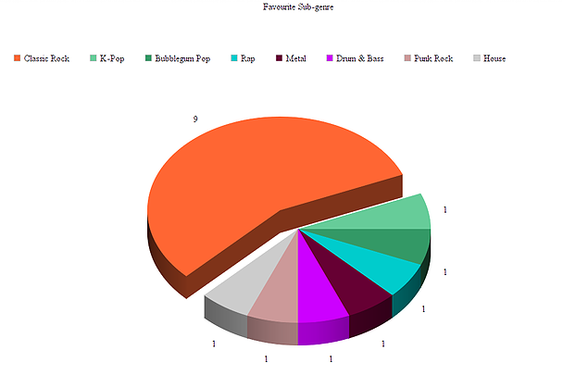
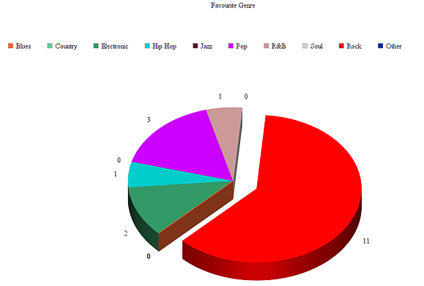
Music which is popular among the potential audience
It is found that the majority of the target audience favours Classic Rock and Rock music.
Upon further research, I found that the sub-genre includes bands such as Led Zeppelin, Rory Gallagher, Black Sabbath, AC/DC, Rolling Stones, Deep Purple, Iggy Pop, Steppenwolf, Eric Clapton, The Guess Who, Rory Gallagher, Blondie, Rainbow, Uriah Heep. In addition to bands such as Panic! At the Disco, Fresh Blood, Iron Maiden, Metallica, Mayday Parade, The Story So Far, Lower than Atlantis, The Hell, Bring Me the Horizon and Black Sabbath are popular amongst the main Genre. These are the artists which I will include in my magazine.

Slide 11
The unique selling point of my magazine
The UPS (unique selling point) of my magazine is that it targets the younger fans of Classic Rock Music, while applying to their interest in other forms of rock music which is more current and relevant but also applies to the classic rock style. Due to the older ages being the stereotypical fans of classic rock music, most magazines are not aimed towards the younger fans of classic rock music, which is where my magazine’s USP lies.

